Slide 1

MADHAV INSTITUTE OF TECHNOLOGY AND SCIENCE Deemed University (Declared under Distinct Category by Ministry of Education, Government of India) NAAC ACCREDITED WITH A++ GRADE
SUBMITTED BY:
Saloni Kushwah(0901MC221061)
Sameeksha Kushwaha(0901MC221062)
Sandeep Hinwar(0901MC221063)
Sanjana Neware(0901MC221064)
Sarvesh Patel(0901MC221065)
SUBMITTED TO:
Dr. Vikash Shinde
Department of Engineering Mathematics & Computing

Slide 2
Introduction to game theory, competitive games, finite and infinte games, two persons zero sum game, pure and mixed strategies , saddle point

Slide 3
Introduction to Game Theory
Game theory is the study of strategic interactions between rational decision-makers. which Analyzes situations where the outcome for each participant depends on the actions of others.
Types of Games:
Cooperative vs. Non-Cooperative: Players collaborate or act independently.
Zero-Sum vs. Non-Zero-Sum: One player’s gain vs. mutual or mixed outcomes.
Simultaneous vs. Sequential: Decisions made at once or in turn.
Competitive Game
Games where players have opposing interests, often in pursuit of maximizing individual payoffs.
For example : Markets (companies competing for market share), sports (one team’s win means the other's loss), Political Campaigns.

Slide 4
Example of Game theory and Competitive game
1. Business Competition (Pricing Wars) - Both companies consider the likely reactions of their competitor before making a pricing decision, often reaching a Nash equilibrium where neither company can improve its position without the other also changing its strategy.
2. The Prisoner's Dilemma (Law Enforcement) - This classic example demonstrates a two-person non-zero-sum game. The Nash equilibrium occurs when both prisoners confess, as each prisoner aims to minimize their potential punishment without trusting the other.
3. Network Traffic Routing - This is a competitive game where packets choose optimal routes, balancing between speed and avoiding congestion. Here, game theory helps to find an equilibrium (like the Wardrop equilibrium) where no packet can reduce travel time by changing its route.
4.Environmental Policies (Tragedy of the Commons) - This is a non-cooperative game and resembles the Tragedy of the Commons. If each participant acts selfishly, resources get depleted. Cooperative strategies (like setting quotas) can lead to a sustainable outcome.

Slide 5
Finite and infinte games
1. Finite Games
A finite game is a game with:
Defined Rules: Finite games have fixed, agreed-upon rules that all players must follow.
Fixed Number of Players: The players are known and typically don’t change throughout the game.
Clear Objective: There is a specific goal, such as winning, and the game ends when this goal is achieved.
Clear Ending: The game concludes with a winner and a loser (or sometimes a draw), and the outcome is decisive.
2. Infinite Games
An infinite game, in contrast, is a game with:
Flexible Rules: Rules can evolve over time, often altered by the players to continue the play rather than to determine a winner.
Changing Players: Participants may come and go, and the number of players is often open-ended.
No Clear Objective of Winning: The goal isn’t to win in a conventional sense but to keep the game going and sustain the play.
Endless Duration: Infinite games don’t have a defined end; they continue indefinitely, with players focused on sustaining the game rather than achieving a final victory.

Slide 6
Applications
Business:
Finite: Competing to beat a rival or hit a quarterly profit target.
Infinite: Focusing on long-term sustainability, customer loyalty, and innovation.
Personal Development:
Finite: Achieving specific goals, like a promotion or fitness milestone.
Infinite: Embracing continuous self-improvement and lifelong learning.
Education:
Finite: Passing exams or getting a degree.
Infinite: Cultivating a love for learning and critical thinking.
Politics:
Finite: Winning an election or passing a particular policy.
Infinite: Supporting long-term social change, like civil rights or environmental justice.

Slide 7
Two person zero –sum game
A two-person zero-sum game is a type of mathematical model in game theory that represents a situation where two players are in direct competition, and one player's gain is exactly equal to the other player's loss. In these games:
Two Players: Only two players are involved, often referred to as Player A and Player B.
Zero-Sum: The sum of the payoffs for both players is always zero for any outcome. If one player wins (positive payoff), the other player loses by an equal amount (negative payoff). This makes it a pure competitive scenario.

Slide 8
Key Concepts
Payoff Matrix:
A matrix is used to represent the outcomes (payoffs) of the game based on each player’s possible strategies.
If A is the payoff matrix for Player A, each element aij ​ represents the outcome for Player A when they choose strategy iii and Player B chooses strategy j.
Player B’s payoff would be −aij ​ for that same outcome, indicating the zero-sum nature.
Optimal Strategies:
Pure Strategy: A player consistently chooses one strategy every time the game is played.
Mixed Strategy: A player uses a probabilistic approach, choosing among strategies according to certain probabilities to keep the opponent guessing.
Players aim to adopt optimal strategies to either maximize their minimum payoff (maximin) or minimize their maximum loss (minimax).
Saddle Point:
A saddle point in the payoff matrix is a value where the optimal strategies intersect. If a saddle point exists, it represents an equilibrium where neither player can benefit from changing strategies, making it the game's solution.
The value of the game at a saddle point indicates the payoff for the player, with Player A aiming to maximize it and Player B to minimize it.

Slide 9
EXAMPLE:
 | Player B
Player A |  | I | II
 | I | 2 | -1
 | II | -1 | 1
This game has no saddle point.
p = 1 - (-1) 2
---------------------- = -------
(2 + 1) - (-1 - 1) 5
1 – p = 3/5
q = 1 - (-1) 2
---------------------- = --------
(2 + 1) - (-1 - 1) 5
1 – q = 3/5
V = 2 X 1 - (-1) X (-1) 1
-------------------------- = --------
(2 + 1) - (-1 - 1) 5

Slide 10
Saddle Points
A saddle point, also known as a minimax point, is a concept primarily used in game theory and optimization.
A saddle point in a payoff matrix occurs when an element in the matrix is simultaneously the minimum value in its row (Player A's best choice) and the maximum value in its column (Player B's best choice).
Saddle Point Method
At the right of each row , write the row minimum and underline the largest of them .
At the bottom of each column , write the column maximum and underline the smallest of them .
If these two element are equal , the corresponding cell is the saddle point and the value is the value of game.

Slide 11
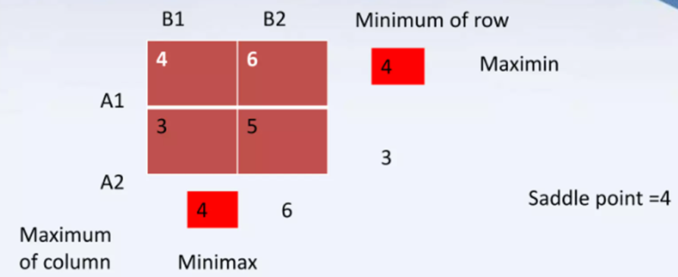
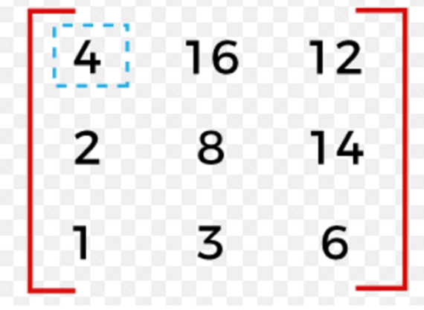
Example:
Saddle point is 4

Slide 12
Pure Strategy
Definition: A pure strategy is a plan where a player consistently chooses the same action every time they are faced with a decision.
Characteristics:
Deterministic: The player follows a fixed rule, choosing one specific option without deviation.
Predictable: Opponents can anticipate the player’s choice if they know their strategy.
Example: In a game of rock-paper-scissors, if a player always chooses "rock," they are using a pure strategy.
When Used:
Useful in situations where a particular move is consistently advantageous.
Often chosen when there is a dominant strategy that provides the best payoff regardless of the opponent’s actions.

Slide 13
Mixed Strategy
Definition: A mixed strategy is a plan where a player chooses between multiple options according to specific probabilities, introducing randomness to their actions.
Characteristics:
Randomized: Actions are selected based on a probability distribution, making it harder for opponents to predict the next move.
Flexible: Mixed strategies allow for adaptation based on the opponent’s tendencies or previous choices.
Example: In rock-paper-scissors, a player might decide to play "rock," "paper," or "scissors" each with a probability of 1/3, making it impossible for the opponent to predict their next move.

Slide 14
THANK YOU☺

